Slide 1
FLUX, REDUX
By Prof. Soleha A Sayyed

Slide 2
Introduction to Flux
Flux is a programming concept, where the data is uni-directional.
This data enters the app and flows through it in one direction until it is rendered on the screen.
Flux Elements
Following is a simple explanation of the flux concept. In the next chapter, we will learn how to implement this into the app.
Actions − Actions are sent to the dispatcher to trigger the data flow.
Dispatcher − This is a central hub of the app. All the data is dispatched and sent to the stores.
Store − Store is the place where the application state and logic are held. Every store is maintaining a particular state and it will update when needed.
View − The view will receive data from the store and re-render the app.

Slide 3
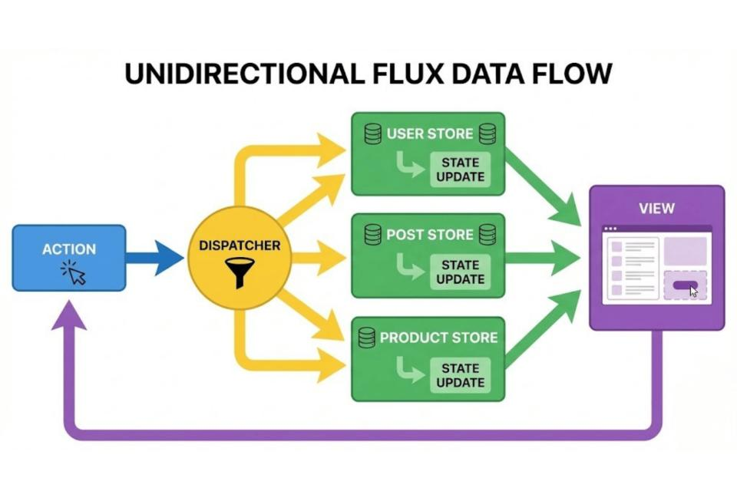
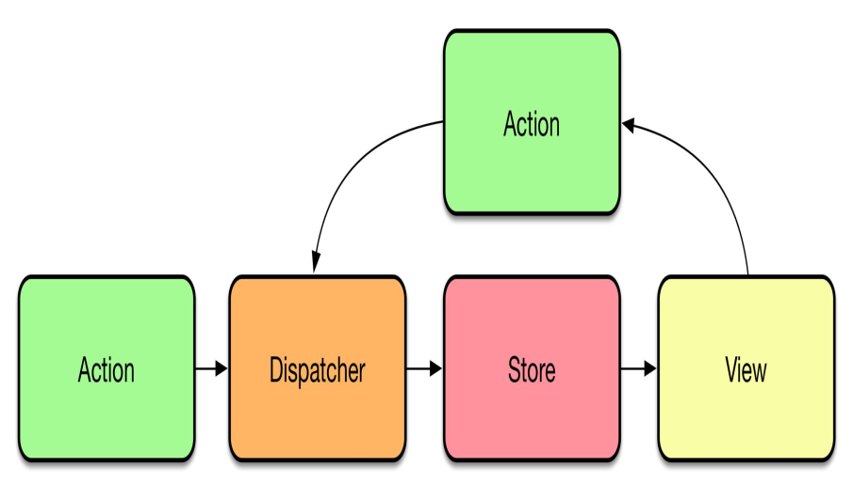
Flux Architecture:
Flux Architecture is an application architecture introduced by Facebook for building predictable and maintainable user interfaces, especially with React.
It uses a one-way data flow, making it easier to understand how data changes over time.

Slide 4
Actions
Represent events or user interactions.
Carry data (payload) to the dispatcher.
Example: Clicking a "Submit" button creates a SUBMIT_FORM action.
Dispatcher
The central hub that receives actions.
Sends each action to all registered stores.
Ensures a controlled flow of data.
Stores
Hold the application's state and business logic.
Update their data in response to dispatched actions.
Notify views when data changes.
Views (React Components)
Display data from the stores.
Listen for store updates and re-render when data changes.
Trigger new actions based on user interactions.

Slide 5
Data Flow in Flux
User Action
↓
Action
↓
Dispatcher
↓
Store
↓
View
↓
User sees updated UI
Example
Suppose a user clicks a Like button:
User clicks Like.
An action LIKE_POST is created.
The dispatcher sends the action to the store.
The store updates the like count.
The view re-renders with the updated count.

Slide 6
Advantages
Predictable and easy-to-follow data flow.
Easier debugging and testing.
Clear separation of concerns. Better scalability for large applications.
Disadvantages
Requires more boilerplate code than simpler state management approaches.
Can be overly complex for small applications.
Managing multiple stores can become challenging.
Flux | MVC
One-way data flow | Two-way data flow
Central dispatcher | Controller manages updates
Stores manage state | Models manage data
Easier to trace state changes | More complex in large applications
Well-suited for React | General-purpose architecture

Slide 7
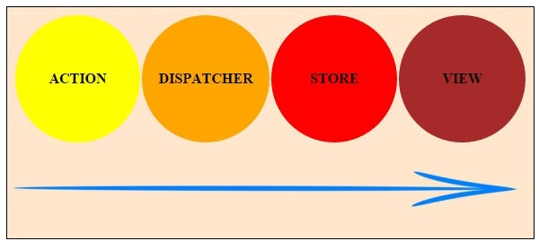
Flux Components
Four major components of Flux:
Dispatcher: It coordinates actions and updates to stores.
Stores: It serves as a container for the app state and logic
Actions: It enables data passing to the dispatcher
Views: It is the same as the view in MVC architecture but in the context of React components.
Flow:
Action => Dispatcher => Store => View

Slide 8
Dispatcher:
The dispatcher is the central hub that manages all Data flow in a flux application, essentially a registry of callbacks into the stores having no intelligence of its own, or we can say that it is a simple mechanism for distributing the actions to the stores.
It is the epicenter of the data flow in any Flux application
It controls what flows into the stores of the Flux application.
It servers as the housing place for the callbacks that are created by the stores and which are linked to the dispatcher.
Each store in the application creates a callback that registers it with the dispatcher.
When an action creator sends a new action to the dispatcher, the dispatcher ensures that due to the callback provided all the registered stores get that action.

Slide 9
Stores:
The store is the hub of the application's state and logic, the role is similar to a model in a traditional MVC.
It registers itself with the dispatcher and provides it with a callback, and this receives action as the parameter.
It contains the logic and state of the Flux application.
Instead of representing a single data structure like a traditional model, the store in Flux can actually represent the state of management of many objects.
It registers itself with a dispatcher and provides it with a callback.
The callback passed to have a parameter that is known as the action, passed to it via the dispatcher.

Slide 10
Actions:
When dispatcher exposes a method that allows us to trigger a dispatch to the stores, and to include a payload of data, which we call an action.
Actions may also come from other places such as servers for example types data during initialization or when the server returns an error code or when the servers have updates to provide to the application.
Actions define the methods, which will be called by the view.
It is the form of data that has been dispatched to the stores.
The methods contain arguments, which contain further instructions on how the view wants to change the store.
The action is responsible for translating dispatch calls to events; which are understandable by the Stores.

Slide 11
Views:
It's not a technical part of Flux but at the same time, views are obviously a critical part of our application.
It is mostly understood as the part of our architecture that's responsible for displaying data to the user, It's the last stop of our data flow architecture.
Views exist outside of flux but are constrained by the unidirectional nature of Flux.
It is simply the composition of the components.
It is the part of the architecture that's responsible for displaying data to the user.
The view layer is the layer where React fits into this architecture.

Slide 12
Introduction to One Store:
What is Redux?
Redux is a state managing library used in JavaScript apps.
It simply manages the state of your application or in other words, it is used to manage the data of the
application.
Why Redux?
It makes easier to manage state and data as the complexity of our application increases.
At the start, it is hard to understand but it really helps to build complex applications.
In starting, it feels like a lot of work, but it is really helpful.
Benefits of Redux:
Predictable State
Easier Debugging
Maintainability Testability

Slide 13
Provider, Component , Actions, Reducers, Sagas , Selector:
Provider:
The <Provider> component from react-redux is a higher-order component that makes the Redux store available to all connected components within its subtree.
It wraps the entire application or the part of the application that needs access to the Redux store.
Example:
import { Provider } from 'react-redux';
import store from './store’;
// Your Redux store
function App() {
return (
<Provider store={store}>
</Provider>
); }

Slide 14
Component:
A standard React component that renders UI and can interact with the Redux store by dispatching actions or consuming state via selectors.
Components can be "connected" to the store using connect from react-redux or Redux hooks like useSelector and useDispatch.
Actions:
Plain JavaScript objects that describe what happened in the application.
They are the only way to trigger a state change.
Actions typically have a type property and may include a payload with relevant data.
Example:
const addTodo = (text) => ({
type: 'ADD_TODO',
payload: { text }
});

Slide 15
Reducers:
Pure functions that take the current state and an action as arguments, and return a new state.
Reducers specify how the application's state changes in response to actions.
They must not mutate the original state directly.
Example:
const todosReducer = (state = [], action) => {
switch (action.type) {
case 'ADD_TODO':
return [...state, { id: Date.now(), text: action.payload.text }];
default:
return state;
}
};

Slide 16
Sagas:
Redux Sagas are a middleware library used for managing side effects (e.g., asynchronous operations like API calls) in Redux applications.
Sagas listen for specific actions and execute logic in response, dispatching new actions upon completion or error.
Example:
import { takeEvery, put } from 'redux-saga/effects';
function* fetchUserSaga(action) {
try {
const user = yield call(api.fetchUser, action.payload.userId);
yield put({ type: 'FETCH_USER_SUCCESS', payload: user });
} catch (error) {
yield put({ type: 'FETCH_USER_FAILURE', error });
} }
function* rootSaga() {
yield takeEvery('FETCH_USER_REQUEST', fetchUserSaga); }

Slide 17
Selectors:
Functions that extract specific pieces of data from the Redux state.
They help to encapsulate state access logic, improve performance by memoization (e.g., using reselect), and make components more reusable as they don't directly manipulate the state structure.
Example:
const getVisibleTodos = (state) => {
// Logic to filter todos based on a visibility filter in state
return state.todos.filter(todo => todo.isVisible);
};

Slide 18
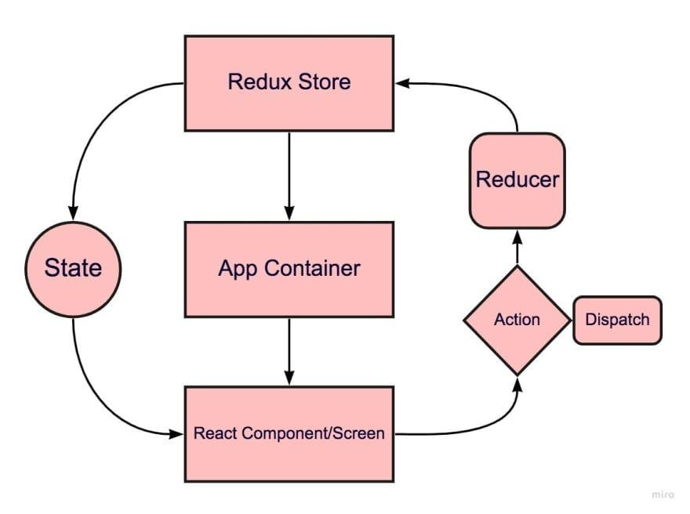
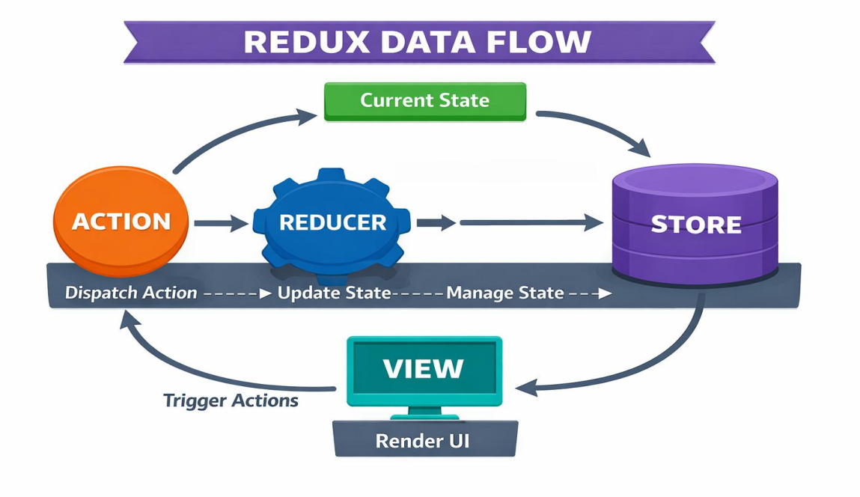
Redux Architecture in React JS
Redux is a state management library commonly used with React applications. It helps manage and share application state in a centralized and predictable way.
Redux is especially useful when many components need to access or modify the same data.

Slide 19
1. Store
The Store is the central place where the application's state is stored.
For example, an application may have:
{ count: 10,
user: "Rahul",
loggedIn: true }
2. Action
An Action describes what happened in the application.
An action is normally a JavaScript object containing a type.
{type: "ADD_STUDENT",
payload: {
name: "Amit",
rollNo: 101 } }

Slide 20
3. Dispatch
Dispatch is used to send an action to Redux.
In React Redux, we commonly use:
dispatch({ type: "INCREMENT" });
4. Reducer
A Reducer is a function that determines how the state should change based on the action.
It receives:
Current state
Action
and returns:
New state
Example:
function counterReducer(state = { count: 0 }, action) {
switch (action.type) {
case "INCREMENT":
return { count: state.count + 1 };
case "DECREMENT":
return { count: state.count - 1 };
default:
return state;
}
}

Slide 21
5. View / React Component
The View is the user interface.
In a React application, React components act as the View.
For example:
function Counter() {
return ( <div>
<h2>Counter</h2>
<button>Increment</button>
</div> ); }
6. Selector
A Selector is a function used to read specific data from the Redux Store.
For example:
const selectCount = state => state.count;

Slide 22
Example:
import { createStore } from 'redux'
function count(state = 0, action) {
switch (action.type) {
case 'INCR':
return state + 1
case 'DECR':
return state – 1
default:
return state
}
}
let sample_store = createStore(count)
sample_store.subscribe(() => console.log(sample_store.getState()))
sample_store.dispatch({ type: 'INCR' }) // Output: 1
sample_store.dispatch({ type: 'INCR' }) // Output: 2
sample_store.dispatch({ type: 'DECR' }) // Output: 1
Output:
| Action Dispatched | Previous State | New State | Output |
|------------------------|-------------------|--------------|----------|
| `'INCR'` | 0 | 1 | 1 |
| `'INCR'` | 1 | 2 | 2 |
| `'DECR'` | 2 | 1 | 1 |

Slide 23
Advantages and Disadvantages of Redux
Advantages
Centralized State
Predictable State Changes
Easy Debugging
Useful for Large Applications
State Can Be Shared
Disadvantages
It can require additional code and concepts.
It may be unnecessary for small applications.
Beginners need to understand actions, reducers, store, dispatch, and selectors.
Poorly structured Redux code can become difficult to maintain.

Slide 24
Difference between Flux and Redux:
Flux | Redux
Multiple Stores can be used | Usually one Store
Uses Dispatcher | No separate Dispatcher
Store contains state and logic | Reducers handle state transitions
Action → Dispatcher → Store | Action → Reducer → Store
More flexible | More structured
Stores can be event-based | State updates are predictable
Flux | Redux

Slide 25
Principles of Redux are as follows:
Single Source of Truth:
Redux emphasizes having a single, immutable store for the entire application's state.
This means all your application's data resides in one JavaScript object within this store.
This principle simplifies state management and makes it easier to track changes and debug issues.
Centralized State:
Instead of individual React components managing their own isolated pieces of state, the store provides a global state that can be accessed and updated by any component that needs it.
This is particularly useful for sharing data between components that are not directly related in the component tree.
Immutability:
The store's state is designed to be immutable.
When a state change occurs, a new state object is created, rather than directly modifying the existing one.

